Slide 1
Cleaning and Combining Data With Pandas
Overview
In this lesson, students will learn how to use the Pandas library to clean data and combine multiple DataFrames.
Duration 120 minutes
Learning Objectives
In this lesson, students will:
Use Pandas to handle missing or problematic data values.
Identify appropriate cleaning strategies for specific types of data.
Use groupby() and JOIN statements to combine data with Pandas.
Create insights from data by splitting and combining data segments.

Slide 2
Pre-Class Materials and Preparation
For remote classrooms: Virtual breakout rooms and Slack may be needed to facilitate the partner exercise and discussions. As you plan for your lesson:
Consider how you’ll create pairs for the partner exercise (randomly, or with pre-assigned partners).
Determine how (if at all) exercise timing may need to be adjusted.
For helpful tips, keep an eye out for the For remote classrooms tag in the speaker notes.
Prepare screenshots and answers to exercises in advance so that they can be easily shared in Slack during your lecture.

Slide 3
Suggested Agenda
Time | Activity
0:00–0:30 | Introduction + Handling Missing Data
0:30–0:55 | Cleaning and Formatting Data
0:55–1:05 | Break
1:05–1:50 | Combining Data
1:50–2:00 | Wrapping Up, Q&A, and Exit Ticket Completion

Slide 4
Jupyter Notebook
The exercises referred to in this lesson can be found in the Python Workbooks + Data folder.

Slide 5
Cleaning and Combining Data With Pandas

Slide 6
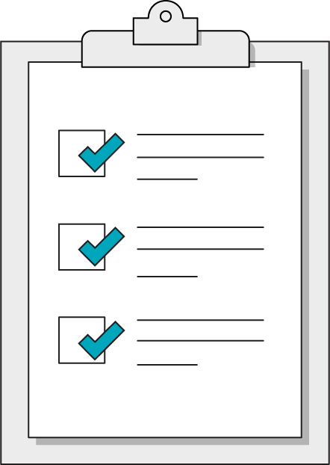
Our Learning Goals
Use Pandas to handle missing or problematic data values.
Identify appropriate cleaning strategies for specific data types.
Use groupby() and JOIN statements to combine data with Pandas.
Create insights from data by splitting and combining data segments.
Notes:
Purpose: Set expectations for the lesson.
TALKING POINTS:
This lesson is simply an introduction to the topic. The suggested methods for handling missing data are by no means comprehensive solutions nor should they be considered a go-to approach for missing data.
This is a big topic worthy of further study after the course has ended.
For remote classrooms:
Capture a screenshot of this slide and drop it in the class Slack channel.

Slide 7
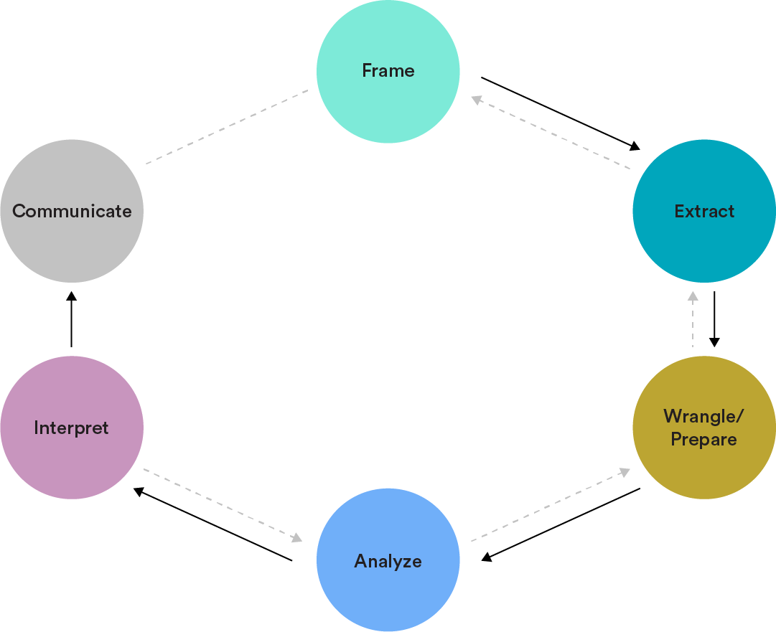
The Data Analytics Workflow
Wrangle/Prepare: Clean and prepare relevant data.
Analyze: Structure, comprehend, and visualize data.
Notes:
Purpose: Set the context for this lesson in terms of the Data Analytics Workflow.

Slide 8
Handling Missing Data
Cleaning and Combining Data With Pandas
Notes:
Duration: 30 minutes

Slide 9

NULLs
A NULL value is any missing value in your data.
One common way of conceptualizing a NULL value is thinking of it as “empty” — not zero, not the word “NULL,” but simply empty.
Notes:
Purpose: Define NULLs.
TALKING POINTS:
A NULL value is a common data issue.

Slide 10
Identifying Missing Data
The first step when dealing with NULLs is to to identify whether or not we’re missing data at all.
We have a few ways to explore missing data, reminiscent of Boolean filters:
# isnull converts values into True if NULL, False otherwise
data_frame.isnull()
# we can then use .sum() to count up the number of NULL values
data_frame.isnull().sum()
Notes:
Purpose: Introduce how to find missing data.

Slide 11
Understanding Missing Data
Finding missing data is the easy part! Determining what to do next is more complicated.
Typically, we’re most interested in knowing why we are missing data. Once we know the “type of missingness” (i.e., the source or cause of missing data), we can proceed effectively. This is essential to deciding whether to delete incomplete values or fill them in and, if so, with what.
Notes:
Purpose: Introduce how to think about the causes behind missing data.

Slide 12
Four Primary Strategies for Handling NULLs
Using external references, find the true value of the missing data and fill it in.
Make educated guesses about what the values could be; impute (i.e., fill in) missing values with the mean, median, or some other number.
Ignore them.
Delete rows containing NULL values.
Proceed with caution! These can rely on dangerous assumptions and are usually not good approaches.
Notes:
Purpose: Introduce the primary approaches for handling NULLs.

Slide 13
Options for Missing Values
 | Rationale | Example
Remove them | For some analyses, rows without a specific column are entirely useless. | df["column"].dropna(inplace=False) df.dropna(subset=["column_a", "column_b"])
Fill with arbitrary value | Useful if you want to keep incomplete records but still mark them with a specific value. | df["column"].fillna("Unknown") df.fillna({"column_a":0, "column_b":100})
Fill with computed value | For some statistical analysis, it may make sense to fill in the mean or median of the complete records. | df["column"].fillna(df["column"].mean())
Notes:
Purpose: Introduce how to think about the causes behind missing data.
TEACHING TIPS:
Note that the examples provide both Series and DataFrame usages of these methods.

Slide 14
More Options for Data Cleaning
 | Rationale | Example
Replace specific values | You can replace a value or regex pattern with something else, which can help standardize data sets | df.replace("Illinois", "IL") # replaces all appearances of "Illinois"with the abbreviation "IL"
Fill with interpolated values | Pandas will automatically calculate missing values based on linear calculations | # given [0,1,NA,3] as a series... df['sales_total'].interpolate() # results in [0,1,2,3]
Notes:
Purpose: Introduce how to think about the causes behind missing data.
TEACHING TIPS:
Note that the examples provide both Series and DataFrame usages of these methods.

Slide 15

10.1 Identifying Missing Data
20 minutes
Let's use the “Orders” table from Superstore to work with missing data in Section 10.1 of the workbook.
Notes:
Purpose: Provide students with an opportunity to practice identifying and handling missing data.

Slide 16
Cleaning and Formatting Data
Cleaning and Combining Data With Pandas
Notes:
Duration: 25 minutes

Slide 17

Data Cleaning
Data cleaning is the process of assembling data into a usable format for analysis.
Common data cleaning actions include:
Reformatting dates so that Python recognizes them.
Extracting day/hour/month/year from a date to aggregate by those categories.
Removing duplicate values or rows.
Combining data sources into one table.
Concatenating or separating data.
Notes:
Purpose: Define data cleaning.
TALKING POINTS:
The data sets that we receive as analysts are often very messy, but there’s no need to be fazed by them.
While we can’t possibly cover every single cleaning function in this course, there are tons of resources out there about cleaning functions.

Slide 18
Modifying Series Within DataFrames
Many of our cleaning operations involve applying an operation to a Series:
data_frame[‘column_a’] = data_frame[‘column_a’].to_numeric()
This can also be used to create new columns based on existing data:
data_frame[‘Fahrenheit’] = data_frame[‘Celsius’] * (9/5) + 32
Notes:
Purpose: Introduce data cleaning in a Series.

Slide 19
Handling Dates and Times
Some of the most challenging, frequently ill-formatted types of data are dates and times. Fortunately, Pandas is on top of it with the .to_datetime() method:
df[‘Column’].to_datetime(inplace=True)
Once a Series has been given a datetime data type, we can use access methods to extract specific time properties, like day or hour.
We can also use the Pandas Timestamp() method to convert data into timestamps:
pd.Timestamp(date_string_or_number)
Notes:
Purpose: Introduce how to clean date data.

Slide 20
Anatomy of a TimeStamp
moment_in_time = pd.TimeStamp("19890602T07:43:55")
moment_in_time.year | 1989
moment_in_time.month | 6
moment_in_time.day | 2
moment_in_time.hour | 7
moment_in_time.minute | 43
moment_in_time.second | 55
Notes:
Purpose: Introduce the individual components of a TimeStamp object
Talking points: Timestamp objects can be difficult to decipher at first! The table and example display how to use the properties of a timestamp.

Slide 21
apply()
There is also the apply() method, which allows us use any function or method:
def strip_dollar_sign(str):
return str.replace("$", "")
df[‘column_a’] = df[‘column_a’].apply(strip_dollar_sign)
If you need to apply a function to each row by row, set axis=1 as an argument.
Notes:
Purpose: Introduce the apply() method.
TEACHING TIPS:
Be sure to highlight the row-by-row argument, as it will be relevant to solving an upcoming workbook challenge.

Slide 22
Addressing Duplicates
Fortunately, the issue of duplicate data is a mere Pandas method away from being solved! We can use the .drop_duplicates() method:
df.drop_duplicates()
If we want to drop duplicates based on certain columns, we can do that, too:
df.drop_duplicates(subset=[‘column_a’, ‘column_b’])
Notes:
Purpose: Explain how to handle duplicate data.
TALKING POINTS:
Thinking about which combination of columns constitutes a removable duplicate is a problem worth addressing during exploratory data analysis.
Some combination of columns will inevitably be duplicates, so determine which exact combinations should never be shared between different rows.

Slide 23

10.2 Cleaning and Formatting Data
15 minutes
Let's use the Superstore data set for Section 10.2 to practice applying cleaning functions.
Notes:
Purpose: Give students an opportunity to practice cleaning data.

Slide 24
Combining Data
Cleaning and Combining Data With Pandas
Notes:
Duration: 45 minutes

Slide 25
Aggregating With groupby()
In Pandas, groupby() statements allow us to segment our population to a specific subset and draw calculations based on those segments.
data_frame.groupby([‘column_a’]).count()
We can think about a groupby() statement in three steps:
Split: Separate our DataFrame into groups according to a specific attribute.
Apply: Apply some function to the groups, like sum, count, or max.
Combine: Put our DataFrame back together.
Notes:
Purpose: Introduce groupby().
TALKING POINTS:
Aggregate findings are vital to generating insights and formulating hypotheses from data, which are often more difficult than simply executing chosen operations on a data set.

Slide 26
Taking Aggregate Measures
We can use the .agg() method to get multiple aggregate values:
df.groupby(‘col_a’)[‘col_b’].agg([‘count’, ‘mean’, ‘min’, ‘max’])
This command...
Takes our DataFrame, df...
Groups it by the values in col_a...
And calculates the count, mean, minimum, and maximum of col_b.
We can also groupby() multiple columns to drill down further:
df.groupby(['first_column', 'second_column'])
Notes:
Purpose: Introduce the .agg() method.

Slide 27

10.3 groupby() Insights
15 minutes
Use groupby() to segment the data from Superstore in Section 10.3.
Notes:
Purpose: Give students an opportunity to practice using groupby().

Slide 28
Concatenate
We can combine two DataFrames together with df.concat(), which gives us the option to stack the DataFrames or add it as new columns.
df1 = pd.DataFrame([[‘a’, 1], [‘b’, 2]], columns=[‘letter’, ‘number’])
df2 = pd.DataFrame([[‘c’, 3], [‘d’, 4]], columns=[‘letter’, ‘number’])
df_with_more_rows = pd.concat([df1, df2])
df_with_more_columns = pd.concat([df1, df2], axis=1)
Notes:
Purpose: Introduce combining data sets with concat().
TEACHING TIPS:
This may be the first time students are seeing DataFrames made simply of lists instead of reading a .csv file.

Slide 29
What Is JOINing?
JOINing is the process of combining DataFrames according to specific values.
Traditionally, this would be done with SQL.
JOINing allows us to:
Reduce the size of a database.
Increase the speed at which data is queried and returned.
Reduce the redundancy of the data stored in the database.
Notes:
Purpose: Introduce JOINs.
TALKING POINTS:
JOINing is fundamental to proper data architecture, and we'll get to do it in Pandas.
TEACHING TIPS:
If students aren’t familiar with SQL, take a moment to define it in relation to Python.

Slide 30
JOINs
A JOIN relies on multiple data sets that share a common unique identifier, or “key.”
drivers
id | name | vehicle_id
1 | Janet | 3
2 | Terrell | 4
3 | Yoko | 4
4 | Lee | 5
vehicles
id | vehicle_name
1 | Explorer
2 | Civic
3 | Corolla
4 | Impala
id | name | vehicle_id | vehicle_name
1 | Janet | 3 | Corolla
2 | Terrell | 4 | Impala
3 | Yoko | 4 | Impala
Notes:
Purpose: Show how JOINs work using a simple example.
TALKING POINTS:
JOIN is used to combine tables for the purpose of adding selection criteria and possibly additional columns.
They connect data sources together in order to use information from both tables to display a desired result.
A JOIN allows for tables to be connected using common columns, which serve as unique identifiers (called KEYS).
Note that unique identifiers aren’t required, but are almost always used to avoid unintended behavior.
In this example, “drivers.id” is the primary key (PK) and “drivers.vehicle_id” is the foreign key (FK) of the “drivers” table.
Conversely, “vehicle.id” is the PK of the “vehicles” table, and there is no FK.
The “drivers” table is the fact table, and the “vehicles” table is the dimension table.

Slide 31
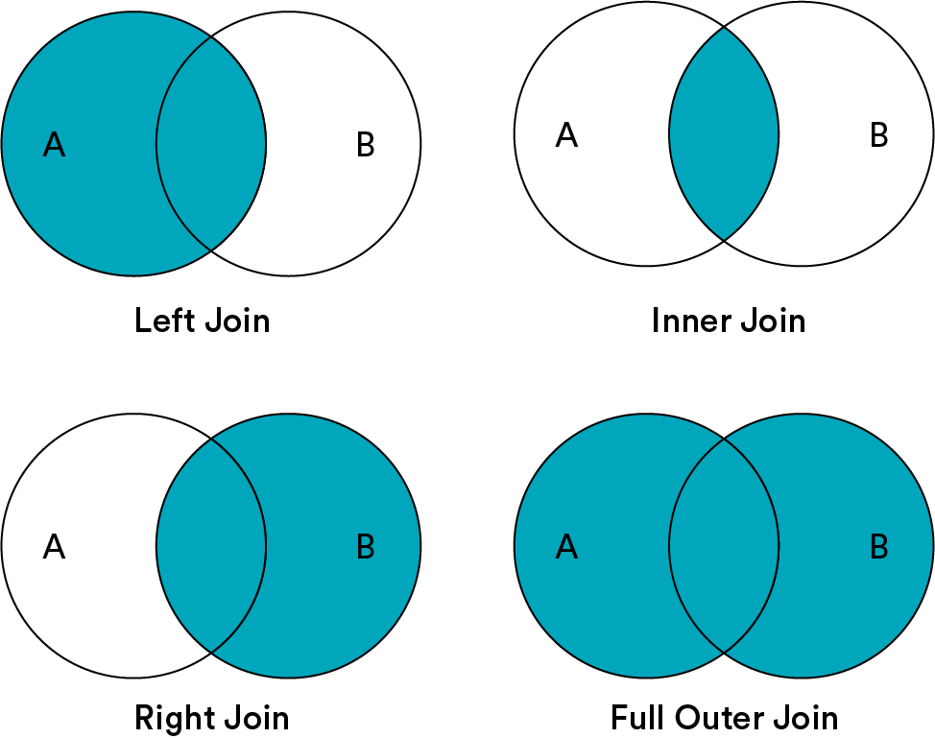
Types of JOINs
INNER JOIN is the same thing as JOIN.
Notes:
Purpose: Introduce four types of JOINs.
TALKING POINTS:
There are four types of JOINs; each has its own use case. You’ll decide which JOINS you want to use based on the tables with which you’re working.
INNER JOIN is the default.
If we don’t want to perform an INNER JOIN, we specify this in the syntax of our query (“LEFT JOIN,” for example).
In this lesson, we’ll focus on INNER and LEFT JOINs.
For now, keep in mind that:
FULL OUTER JOIN is also known as OUTER JOIN.
LEFT JOIN is also known as LEFT OUTER JOIN.
RIGHT JOIN is also known as RIGHT OUTER JOIN.

Slide 32
Using merge
The robust method for JOINing in Pandas is merge(), which accepts several parameters:
pd.merge(left_df, right_df, how, left_on, right_on)
As you may have guessed, the first two parameters are the DataFrames to JOIN. The third parameter describes the type of JOIN, typically “left.” The last two parameters provide the column name for the shared column, or foreign key, that will be used to combine the two DataFrames.
Notes:
Purpose: Introduce merge().
TEACHING TIPS:
We provide an example of this in the first exercise in the workbook, so students will have a more concrete example than this one from which to start working.

Slide 33

10.4 JOINing Data Sets
15 minutes
Let’s practice JOINing stock data and the Superstore data in Section 10.4 of the workbook.

Slide 34
Wrapping Up
Cleaning and Combining Data With Pandas
Notes:
Duration: 10 minutes

Slide 35
Recap
Looking Ahead
In today’s class, we…
Used Pandas to handle missing or problematic data values.
Identified appropriate cleaning strategies for specific types of data.
Used groupby() and JOIN statements to combine data with Pandas.
Created insights from data by splitting and combining data segments.
On your own:
Work through the Python progress assessment on myGA (due at the end of the unit).
Be sure to have instructor approval for your capstone project.
Join someone else’s project or invite others to join yours!
Next Class:
Python Unit Lab
Notes:
Purpose: Recap what was covered in the lesson.

Slide 36

Don’t Forget: Exit Tickets!

